Slide 1
2. Supervised Learning (I)
IT 348/448

Slide 2
Topics
Supervised Learning
Naïve Bayes Classifier
Decision Tree
Support Vector Machines

Slide 3
Reading Assignment
Chapter 2 (in Muller and Guido)
Chapter 2 (in Geron)

Slide 4
Supervised Learning
Given training set of N examples of y = f(x)
(x₁,y₁), (x₂,y₂), (x₃,y₃), …, (x_{N},y_{N})
Find hypothesis (or a model) h that approximates f

Slide 5
Supervised learning Process
1.
Training
Data
Classification Method
Classification Model
Test
Data
Accuracy
2.
Classification Model
New
Data
Classification Model
Class
3.

Slide 6
Supervised Learning
Naïve Bayes Classifier
Decision Tree
SVM

Slide 7
Bayes Theorem (or Bayes rule)

Slide 8
From Conditional Probability
The conditional probability of X and Y are related to their joint probability
Where X and Y are dependent
From product rule
P(X,Y) = P(Y|X) P(X)
P(Y,X) = P(X|Y) P(Y)
Rearranging these two expressions leads to
This is known as the Bayes theorem

Slide 9
Bayes Rule
Follows from definition of conditional probability:
General case of Bayes’ rule for multivalued variables:

Slide 10
Bayes Rule
The general case of Bayes’ rule for multivalued variables:
Where P(X) is called a normalization constant.
The general form of Bayes’ rule with normalization:
P(Y|X) = P(X|Y) P(Y)

Slide 11
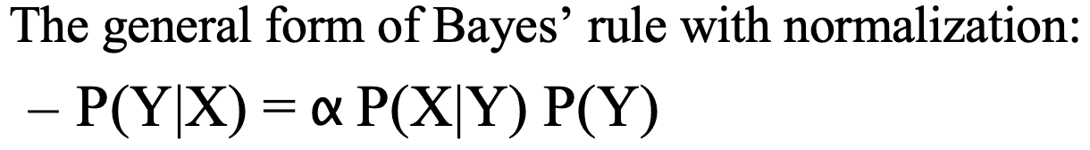
Naïve Bayes

Slide 12
Naïve Bayes
Be careful
Conditional independence is rarely absolutely true
For example, cold weather makes my teeth hurt
Probabilities estimated from data

Slide 13
Naïve Bayes Classifiers

Slide 14
Simple Bayesian Reasoning
Given a hypothesis h and data D which bears on the hypothesis:
P(h): independent probability of h: prior probability
P(D): independent probability of D
P(D|h): conditional probability of D given h
P(h|D): conditional probability of h given D: posterior probability

Slide 15
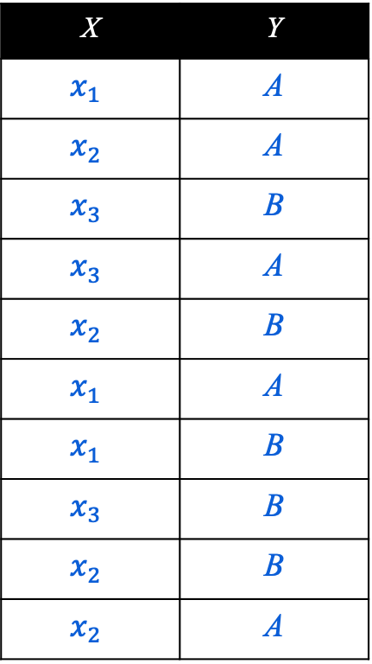
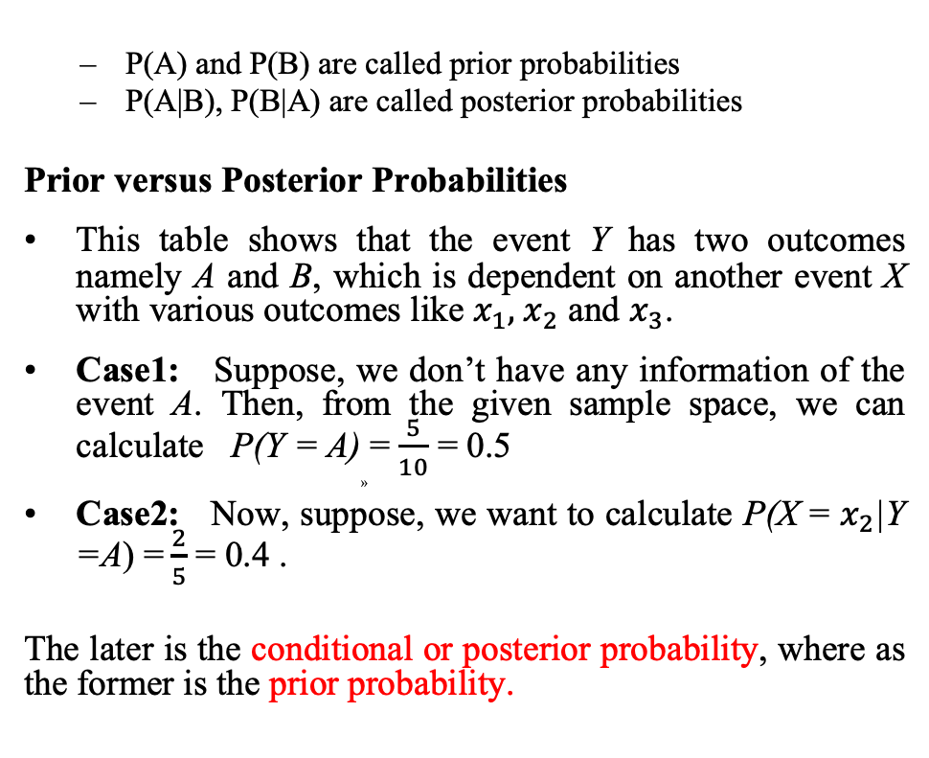
Prior and Posterior Probabilities
X | Y
$$x_{1}$$ | A
$$x_{2}$$ | A
$$x_{3}$$ | B
$$x_{3}$$ | A
$$x_{2}$$ | B
$$x_{1}$$ | A
$$x_{1}$$ | B
$$x_{3}$$ | B
$$x_{2}$$ | B
$$x_{2}$$ | A
P(A) and P(B) are called prior probabilities
P(A|B), P(B|A) are called posterior probabilities
Prior versus Posterior Probabilities
This table shows that the event Y has two outcomes namely A and B, which is dependent on another event X with various outcomes like $x_{1},{ x}_{2}$ and $x_{3}$.
Case1: Suppose, we don’t have any information of the event A. Then, from the given sample space, we can calculate P(Y = A) =$\frac{5}{10}$ = 0.5
Case2: Now, suppose, we want to calculate P(X = $x_{2}$|Y =A) =$\frac{2}{5}$ = 0.4 .
The later is the conditional or posterior probability, where as the former is the prior probability.

Slide 16
Maximum A Posterior
Based on Bayes Theorem, we can compute the Maximum A Posterior (MAP) hypothesis for the data
We are interested in the best hypothesis for some space H given observed training data D.
H: set of all hypothesis.
Note that we can drop P(D) as the probability of the data is constant (and independent of the hypothesis).

Slide 17
Bayes Classifiers
Assumption: training set consists of instances of different classes described c_{j} as conjunctions of attributes values
Task: Classify a new instance d based on a tuple of attribute values into one of the classes c_{j} ∈ C
Key idea: assign the most probable class using Bayes Theorem.

Slide 18
Parameters estimation
P(c_{j})
Can be estimated from the frequency of classes in the training examples.
Independence Assumption: attribute values are conditionally independent given the target value: naïve Bayes.
(Where C_{NB} = C_{MAP} )

Slide 19
Properties
Estimating instead of greatly reduces the number of parameters (and the data sparseness).
The learning step in Naïve Bayes consists of estimating and based on the frequencies in the training data
An unseen instance is classified by computing the class that maximizes the posterior
When conditional independence is satisfied, Naïve Bayes corresponds to MAP classification.

Slide 20
Supervised learning Process
1.
Training
Data
Classification Method
Classification Model
Test
Data
Accuracy
2.
Classification Model
New
Data
Classification Model
Class
3.

Slide 21
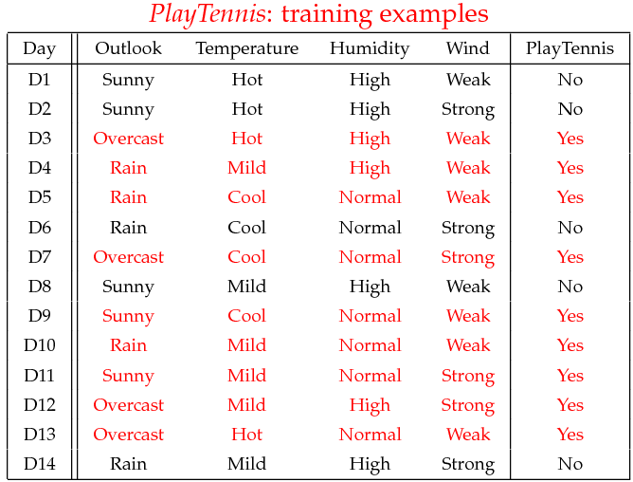
Example: ‘Play Tennis’ data
P(Play=Yes) = 9/14
P(Play=No) = 5/14
Testing case: data to be classified
x’=(Outlook=Sunny, Temperature=Cool, Humidity=High, Wind=Strong)

Slide 22
Learning Phase
P(Outlook=o|Play=b) P(Temperature=t|Play=b)
Outlook | Play=Yes | Play=No
Sunny | 2/9 | 3/5
Overcast | 4/9 | 0/5
Rain | 3/9 | 2/5
Temperature | Play=Yes | Play=No
Hot | 2/9 | 2/5
Mild | 4/9 | 2/5
Cool | 3/9 | 1/5
P(Humidity=h|Play=b) P(Wind=w|Play=b)
Humidity | Play=Yes | Play=No
High | 3/9 | 4/5
Normal | 6/9 | 1/5
Wind | Play=Yes | Play=No
Strong | 3/9 | 3/5
Weak | 6/9 | 2/5
P(Play=Yes) = 9/14
P(Play=No) = 5/14

Slide 23
Testing Phase
Test Phase
Given a new instance,
x’=(Outlook=Sunny, Temperature=Cool, Humidity=High, Wind=Strong)
Look up tables
MAP calculation
P(Outlook=Sunny|Play=Yes) = 2/9
P(Temperature=Cool|Play=Yes) = 3/9
P(Huminity=High|Play=Yes) = 3/9
P(Wind=Strong|Play=Yes) = 3/9
P(Play=Yes) = 9/14
P(Outlook=Sunny|Play=No) = 3/5
P(Temperature=Cool|Play==No) = 1/5
P(Huminity=High|Play=No) = 4/5
P(Wind=Strong|Play=No) = 3/5
P(Play=No) = 5/14
P(Yes|x’): [P(Sunny|Yes)P(Cool|Yes)P(High|Yes)P(Strong|Yes)]P(Play=Yes) = 0.0053
P(No|x’): [P(Sunny|No) P(Cool|No)P(High|No)P(Strong|No)]P(Play=No) = 0.0206
Given the fact P(Yes|x’) < P(No|x’), we label x’ to be “No”.

Slide 24
Avoiding the Zero-Probability Problem
Naïve Bayesian prediction requires each conditional prob. be non-zero. Otherwise, the predicted prob. will be zero
Example
Suppose a dataset with 1000 tuples, income=low (0), income= medium (990), and income = high (10)
Use Laplacian correction (or Laplacian estimator)
Adding 1 to each case
Prob(income = low) = 1/1003
Prob(income = medium) = 991/1003
Prob(income = high) = 11/1003
The “corrected” prob. estimates are close to their “uncorrected” counterparts

Slide 25
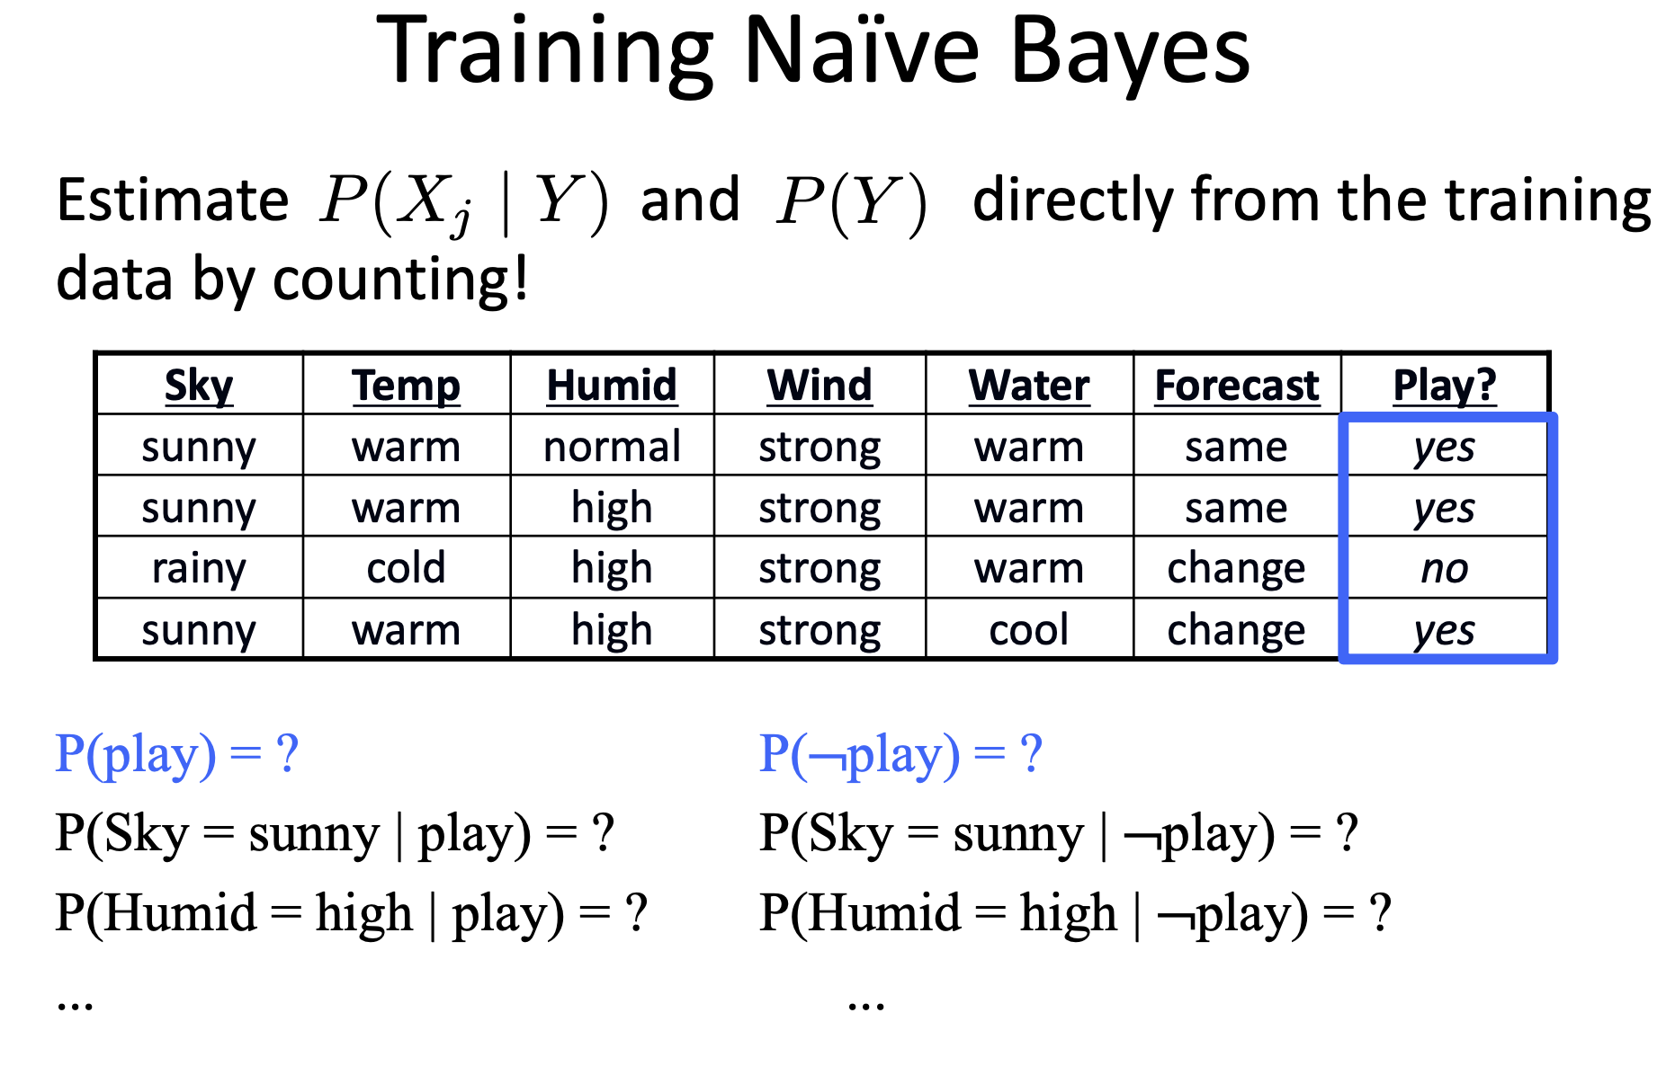

Slide 26
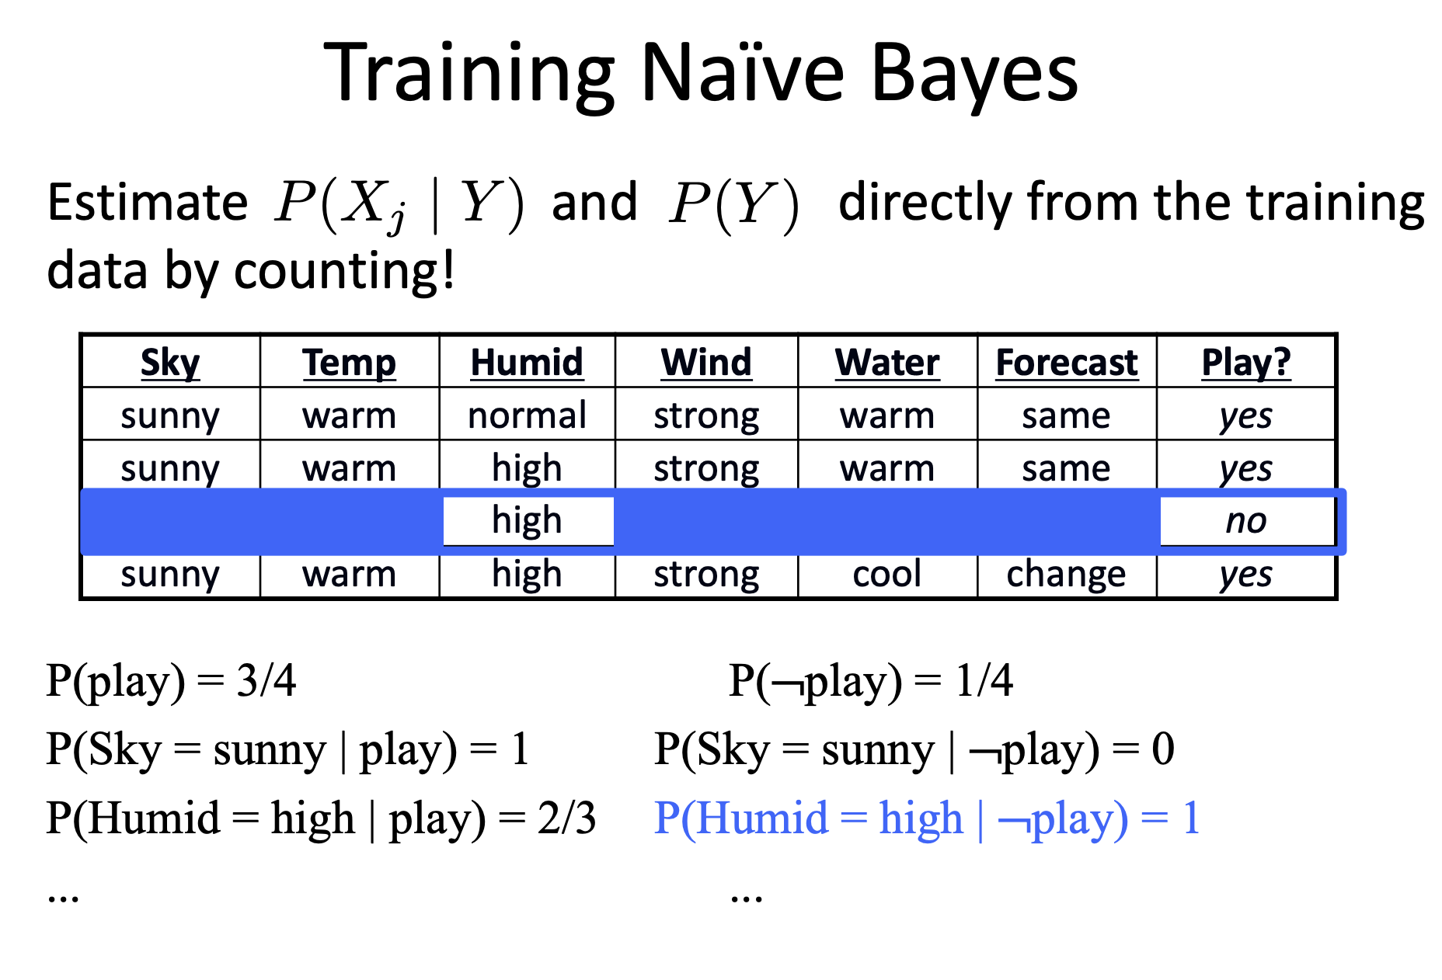

Slide 27
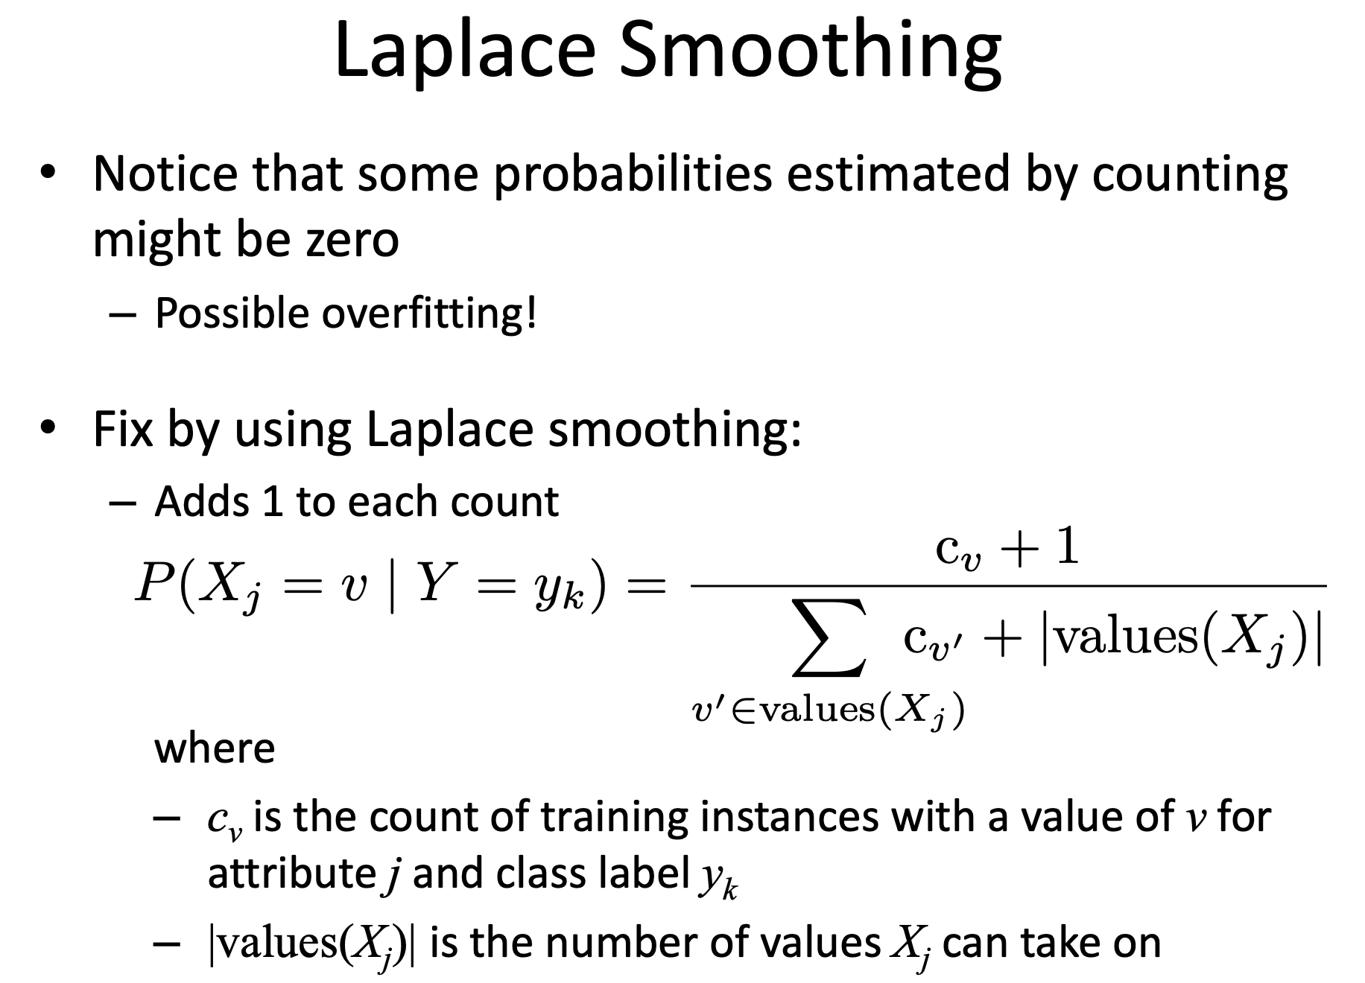

Slide 28
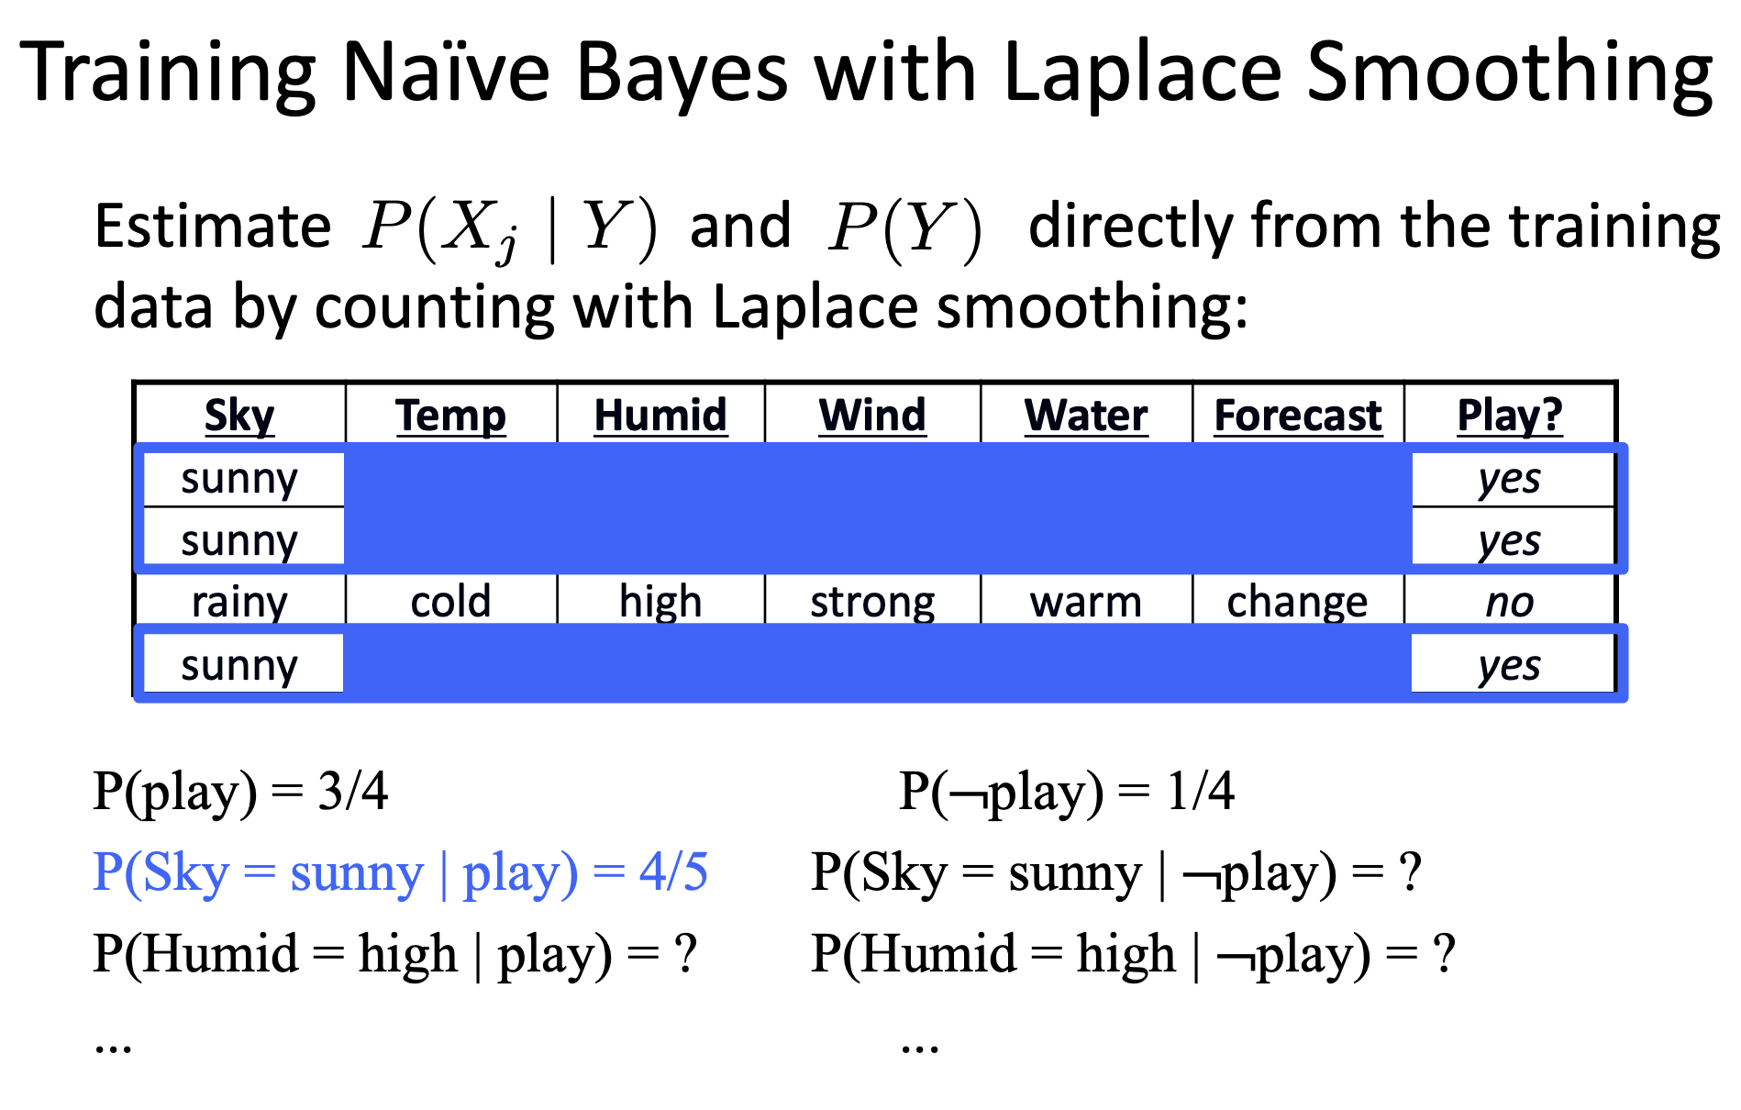

Slide 29
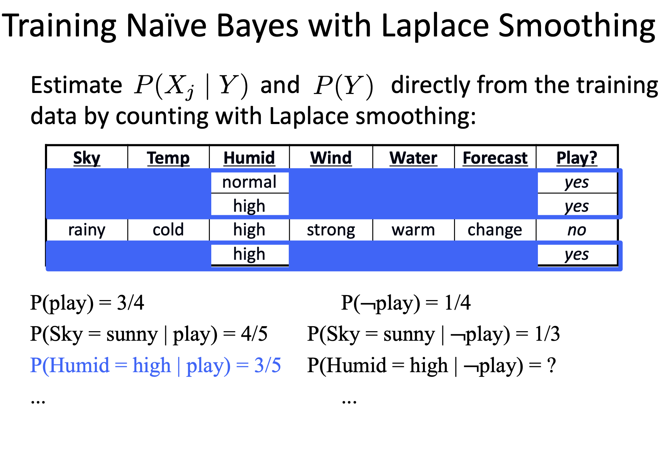

Slide 30
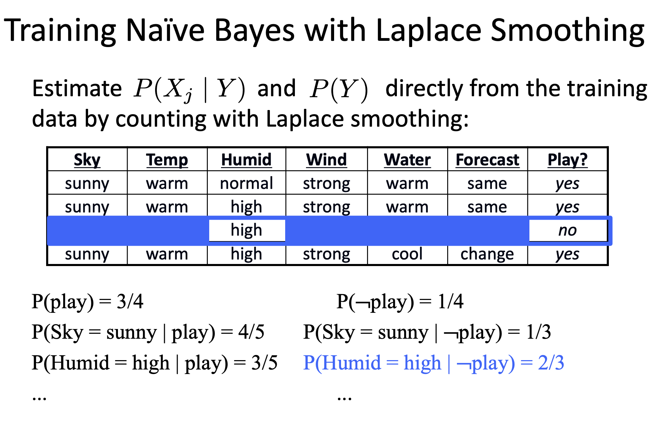

Slide 31
Conclusions
Naïve Bayes based on the independence assumption
Training is very easy and fast; just requiring considering each attribute in each class separately
Test is straightforward; just looking up tables or calculating conditional probabilities with normal distributions
A popular generative model
Performance competitive to most of state-of-the-art classifiers even in presence of violating independence assumption
Many successful applications, e.g., spam mail filtering
Apart from classification, naïve Bayes can do more…

Slide 32
Conclusions
Advantages
Easy to implement
Good results obtained in most of the cases
Disadvantages
Assumption: class conditional independence, therefore loss of accuracy
Practically, dependencies exist among variables
E.g., hospitals: patients: Profile: age, family history, etc.
Symptoms: fever, cough etc., Disease: lung cancer, diabetes, etc.
Dependencies among these cannot be modeled by Naïve Bayes Classifier
How to deal with these dependencies?
Bayesian Belief Networks

